Slide 1
Introduction to Sorting

Slide 2
What is Sorting?
Sorting is the process of arranging elements in a specific order (ascending or descending).
It is a fundamental operation in computer science and is used extensively in various applications.
Efficient sorting algorithms are crucial for optimizing data processing and searching.

Slide 3
Importance of Sorting
Sorting plays a key role in data organization and management.
Helps in faster retrieval and search operations in databases.
Essential in applications like e-commerce, data analytics, and computer graphics.

Slide 4
Internal Sorting
Internal Sorting: Sorting of data that can be performed entirely within the computer's main memory.
Suitable for relatively smaller datasets that can fit into RAM.
Examples: Bubble Sort, Selection Sort, Insertion Sort, Merge Sort, Quick Sort, Heap Sort.

Slide 5
External Sorting
External Sorting: Sorting of data that exceeds the capacity of the computer's main memory.
Involves reading data from external storage (e.g., disk) and writing intermediate and final results back to the disk.
Suitable for large datasets that cannot fit entirely into RAM.
Examples: External Merge Sort, External Quick Sort.

Slide 6
Comparison of Internal and External Sorting
Internal Sorting is faster than External Sorting due to faster access times in main memory.
External Sorting is necessary when dealing with large datasets that cannot fit in RAM.
External Sorting involves additional I/O operations, making it slower than internal sorting for smaller datasets.

Slide 7
Elementary Sorting Algorithm

Slide 8
Definition
An elementary sorting algorithm is a simple and basic sorting method used to sort a list of elements.
These algorithms are often straightforward to implement but may not be the most efficient for large datasets.
They are primarily used for educational purposes or as building blocks for more advanced sorting algorithms.

Slide 9
Insertion Sort
Insertion Sort is a simple sorting algorithm that builds the final sorted array one element at a time.
It efficiently sorts small datasets and performs well on almost-sorted lists.

Slide 10
Algorithm Steps
Start from the second element (index 1) and consider it as the "key."
Compare the key with the elements to its left and move larger elements one position ahead to create space for the key.
Insert the key into the correct position among the already sorted elements.

Slide 11
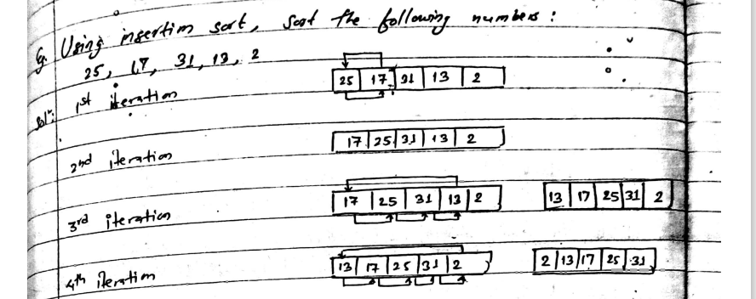
Algorithm Steps (Example)

Slide 12
Time Complexity
In the worst and average cases, Insertion Sort has a time complexity of O(n^2).
For nearly sorted or small datasets, it can perform with a best-case time complexity of O(n).

Slide 13
Advantages and Disadvantages
Advantages
Simple to implement and understand.
Efficient for small datasets or lists that are nearly sorted.
In-place sorting algorithm, requires minimal additional memory.
Disadvantages
Inefficient for large datasets compared to more advanced sorting algorithms.
Time complexity makes it unsuitable for big data applications.

Slide 14
When to Use Insertion Sort
Insertion Sort is suitable for small datasets or when the list is nearly sorted.
It is a good choice for sorting small arrays or for use in conjunction with other sorting algorithms.

Slide 15
Example: Insertion Sort in C
Insertion sort

Slide 16
Selection Sort
Selection Sort is a simple sorting algorithm that divides the input into two parts: the sorted part and the unsorted part.
It repeatedly finds the minimum (or maximum) element from the unsorted part and places it at the beginning (or end) of the sorted part.

Slide 17
Algorithm Steps
Start with the first element as the minimum (or maximum) element.
Compare the minimum (or maximum) element with the rest of the unsorted elements.
If a smaller (or larger) element is found, update the minimum (or maximum) element to the new element.
Swap the minimum (or maximum) element with the first unsorted element.
Move the boundary between the sorted and unsorted parts.

Slide 18
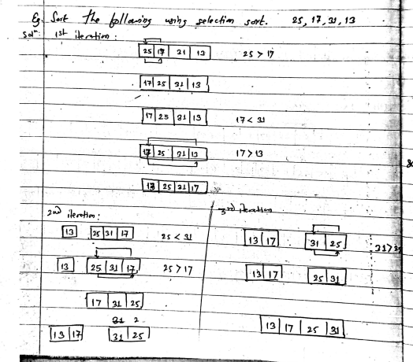
Algorithm Steps (Example)

Slide 19
Time Complexity
In the worst, average, and best cases, Selection Sort has a time complexity of O(n^2).
It makes n-1 passes over the list, and in each pass, it performs n-i comparisons.

Slide 20
Advantages and Disadvantages
Advantages
Simple to implement and understand.
Requires minimal additional memory (in-place sorting).
Performs well on small datasets or lists that are partially sorted.
Disadvantages
Inefficient for large datasets compared to more advanced sorting algorithms.
Time complexity makes it unsuitable for big data applications.

Slide 21
When to Use Selection Sort
Selection Sort is suitable for small datasets or when partial sorting is required.
It can be used when the memory space is limited as it requires minimal additional memory.

Slide 22
Example: Selection Sort in C
Selection sort

Slide 23
Bubble Sort
Bubble Sort is a simple sorting algorithm that repeatedly compares adjacent elements and swaps them if they are in the wrong order.
The largest (or smallest, depending on the sorting order) element "bubbles" to its correct position in each pass.

Slide 24
Algorithm Steps
Start at the beginning of the list.
Compare each pair of adjacent elements.
If they are in the wrong order, swap them.
Repeat steps 2-3 for the entire list until no more swaps are needed (indicating the list is sorted).

Slide 25
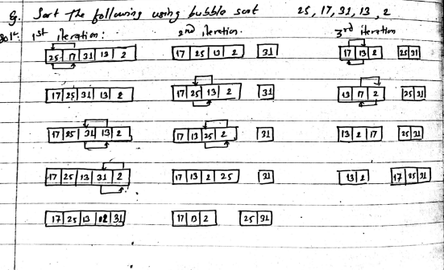
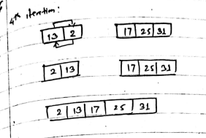
Algorithm Steps (Example)

Slide 26
Time Complexity
In the worst and average cases, Bubble Sort has a time complexity of O(n^2).
It makes n-1 passes over the list, and in each pass, it performs n-i comparisons and possibly n-i swaps.

Slide 27
Advantages and Disadvantages
Advantages
Simple to implement and understand.
Requires minimal additional memory (in-place sorting).
Performs well on small datasets or lists that are partially sorted.
Disadvantages
Inefficient for large datasets compared to more advanced sorting algorithms.
Time complexity makes it unsuitable for big data applications.
Not stable, meaning the relative order of equal elements may change.

Slide 28
When to Use Bubble Sort
Bubble Sort is suitable for small datasets or when partial sorting is required.
It can be used when the memory space is limited as it requires minimal additional memory.

Slide 29
Example: Bubble Sort in C
Bubble sort

Slide 30
Divide and Conquer Algorithm

Slide 31
Introduction:
Divide and Conquer is a problem-solving technique that involves breaking down a complex problem into smaller, more manageable subproblems.
Each subproblem is solved independently, and the solutions are combined to solve the original problem.
The process of breaking down the problem, solving the subproblems, and combining the solutions is repeated recursively until the problem is solved.

Slide 32
Steps of the Divide and Conquer Algorithm:
Divide: Break the problem into smaller subproblems.
Conquer: Solve the subproblems independently (usually recursively).
Combine: Merge or combine the solutions of the subproblems to obtain the final solution.

Slide 33
Characteristics of Divide and Conquer Algorithm:
The problem is divided into smaller subproblems, which are usually of the same type as the original problem.
The subproblems are solved independently, often using recursive calls.
The solutions of the subproblems are combined to obtain the final solution.
It typically involves a divide step, a conquer step, and a combine step.

Slide 34
Examples of Divide and Conquer Algorithm:
Binary search: Divide the sorted array in half, compare the target with the middle element, and recursively search in the appropriate half.
Merge sort: Divide the unsorted array into two halves, recursively sort the two halves, and merge them to obtain a sorted array.
Quick sort: Choose a pivot, partition the array around the pivot, and recursively apply quick sort to the subarrays.
Closest pair problem: Divide the set of points into two halves, recursively find the closest pairs in each half, and combine the solutions.

Slide 35
Advantages of Divide and Conquer Algorithm:
Breaks down a complex problem into simpler subproblems, making it easier to solve.
Allows for parallelism and efficient utilization of resources.
Enables the use of recursion, which can provide an elegant and concise solution.
Often provides efficient algorithms with better time complexity than naive approaches.

Slide 36
Limitations of Divide and Conquer Algorithm:
The overhead of dividing and combining the subproblems may affect the overall efficiency.
Some problems may not naturally lend themselves to a divide and conquer approach.
The recursive nature of the algorithm may require significant memory space for function calls.

Slide 37
Merge Sort
Merge Sort is a divide-and-conquer sorting algorithm that divides the input into two halves, sorts them, and then merges them to produce the final sorted array.
It is an efficient and stable sorting algorithm.

Slide 38
Algorithm Steps
Divide the unsorted array into two halves.
Recursively sort each half.
Merge the two sorted halves.

Slide 39
Algorithm Steps (Example)
[Visualization of the Merge Sort algorithm with step-by-step sorting of [64, 34, 25, 12, 22, 11]]
Pass 1: [64], [34], [25], [12], [22], [11] (Divided)
Pass 2: [34, 64], [12, 25], [11, 22] (Sorted and Merged)
Pass 3: [12, 25, 34, 64], [11, 22] (Sorted and Merged)
Pass 4: [11, 12, 22, 25, 34, 64] (Sorted and Merged)

Slide 40
Time Complexity
In all cases (worst, average, and best), Merge Sort has a time complexity of O(n log n).
It divides the array into halves log n times, and merging takes linear time.

Slide 41
Advantages and Disadvantages
Advantages
Efficient for large datasets and all cases.
Guarantees stability, preserving the relative order of equal elements.
Well-suited for external sorting, where data is too large to fit in memory.
Disadvantages
Merge Sort uses additional memory for merging, which can be a disadvantage for limited memory systems.
It may have slightly higher overhead compared to some other sorting algorithms.

Slide 42
When to Use Merge Sort
Merge Sort is suitable for large datasets and all cases.
It is an excellent choice when stability and guaranteed performance are essential.

